Slide 1


Distributed COM
COM Programming
Notes:
Page <number>
WNCOMPG-2 v1.5
Chapter 12, Distributed COM

Slide 2


Chapter Overview
DCOM Security
  Authentication and access control
Remoting existing objects
  Using tools and programmatically
Initialising DCOM
DCOM configuration
Creating remote objects
Notes:
Page <number>
WNCOMPG-2 v1.5
Chapter 12, Distributed COM

Slide 3
DCOM Security Overview
The DCOM security model encompasses 4 key issues
  Launch and Identity control
  Authentication and Access control
Client
1
Activation
Server
principal
credential
SCM
3
Launch Permissions
2
Authentication
Registry
principal
credential
4
Launch
5
Method Call
Specified Identity
6
Access control check
Notes:
Page <number>
WNCOMPG-2 v1.5
Chapter 12, Distributed COM

Slide 4
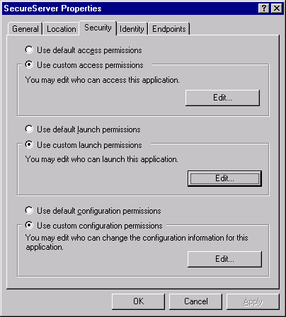
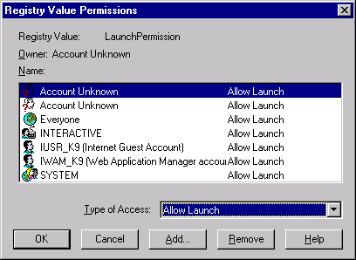
Launch Control
Launch permissions are used to determine which users can start server processes
Notes:
Page <number>
WNCOMPG-2 v1.5
Chapter 12, Distributed COM

Slide 5
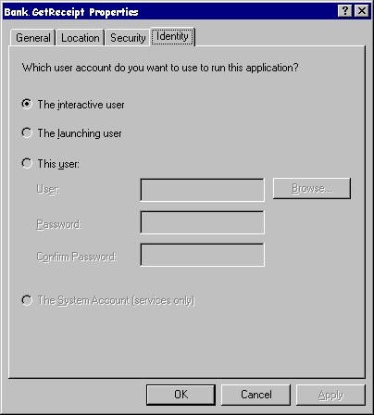
Identity Control
Determining under which user account the component will execute
Component runs under account of currently logged on user. OK for testing and debugging. Component has access to desktop.
RARELY USED FOR PRODUCTION SERVERS.
Component runs under client’s account. Very limited scalability. Each client forces new Window Station.
DO NOT USE FOR PRODUCTION SERVERS.
Component runs under specified account. Account must have "Logon as a batch job" privilege.
THE BEST CHOICE FOR PRODUCTION SERVERS.
Notes:
Page <number>
WNCOMPG-2 v1.5
Chapter 12, Distributed COM

Slide 6
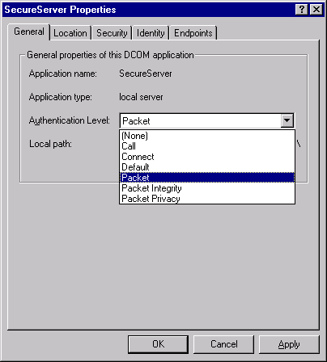
Authentication
Determining the caller’s identity
Notes:
Page <number>
WNCOMPG-2 v1.5
Chapter 12, Distributed COM

Slide 7
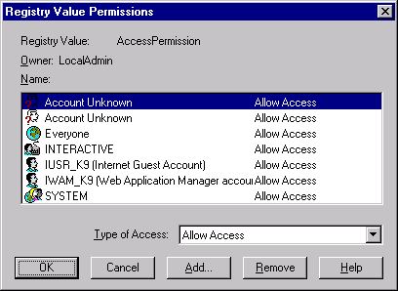
Access Control
Determining the if caller is allowed access
Notes:
Page <number>
WNCOMPG-2 v1.5
Chapter 12, Distributed COM

Slide 8
Remoting Existing Objects
Without any source code changes
  Some changes to registry entries
  Can use DCOMCNFG and/or OLEView
Programmatically
  CoCreateInstanceEx( )
Notes:
Page <number>
WNCOMPG-2 v1.5
Chapter 12, Distributed COM

Slide 9
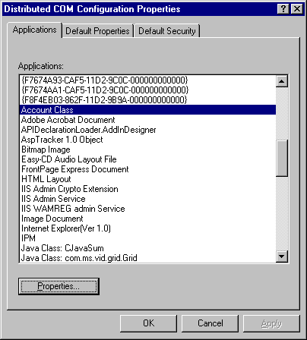
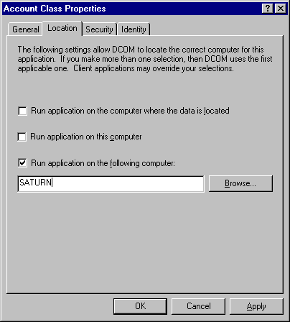
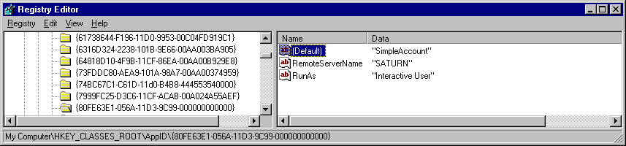
Using DCOMCNFG on Local Machine
Adds a RemoteServerName value to corresponding AppID Registry key
Notes:
Page <number>
WNCOMPG-2 v1.5
Chapter 12, Distributed COM

Slide 10


Moving Server to a Remote Machine
No change required to server or client code
On both machines:
  Register EXE server and proxy-stub DLL
    SimpleAccount -regserver
    regsvr32 SimpleAccountps.dll
On remote machine:
  Register ATL runtime
    regsvr32 atl.dll
  Use DCOMCNFG tool to ensure client has launch and access permissions
    Double-click on Account Class, then select Security tab in Account Class Properties, etc.
On local machine:
  Use DCOMCNFG tool to specify location of remote server
    Double-click on Account Class, click on Location tab, etc.
    (see next slide)
Notes:
Page <number>
WNCOMPG-2 v1.5
Chapter 12, Distributed COM

Slide 11
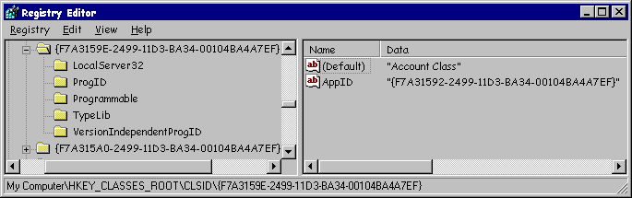
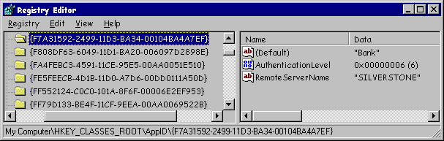
The APPID Registry Key
DCOM introduces the APPID key
  To maintain per-server settings
Remote machine that
object will run on
Many classes can relate
to the same APPID
Notes:
Page <number>
WNCOMPG-2 v1.5
Chapter 12, Distributed COM

Slide 12
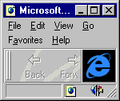
Remoting Programmatically
CoCreateInstanceEx()
  Similar to CoCreateInstance()
Takes a COSERVERINFO structure
  Specifies name of machine on which to instantiate the object
  CoGetClassObject() takes a COSERVERINFO structure
Also takes an array of MULTI_QI structures
CoCreateInstanceEx()
Object
Returns interface pointer(s)
Notes:
Page <number>
WNCOMPG-2 v1.5
Chapter 12, Distributed COM

Slide 13
MULTI_QI
Interface ID (by reference)
struct MULTI_QI
{
const IID *pIID;
IUnknown *pItf;
HRESULT hr;
};
Returned interface pointer.
Must be 0 on entry
HRESULT for this interface ID.
Must be 0 on entry
Notes:
Page <number>
WNCOMPG-2 v1.5
Chapter 12, Distributed COM

Slide 14
Using CoCreateInstanceEx()
Server machine can be specified programmatically
// AccountClient.cpp
#include "SimpleAccount.h"
int main(int argc, char* argv[])
{
CoInitialize( 0 );
COSERVERINFO ServerInfo = {0, L"Jupiter", 0, 0};
MULTI_QI mqi = {&IID_IAccount, 0, S_OK};
HRESULT hr = CoCreateInstanceEx( CLSID_Account,
NULL,
CLSCTX_REMOTE_SERVER,
&ServerInfo,
1, // number of interfaces
&mqi );
if( SUCEEDED(hr) )
{
IAccount *pIAccount = reinterpret_cast<IAccount*>(mqi.pItf);
pIAccount->Deposit(10000.00);
pIAccount->Release();
}
...
Notes:
Page <number>
WNCOMPG-2 v1.5
Chapter 12, Distributed COM

Slide 15
Remote Activation Steps
CLSCTX_ALL
Client makes
activation request
APPID
Lookup CLSID
beneath
[HKCR\CLSID]
Remote_
ServerName
Yes
Forward to SCM
on remote machine
No
CLSID
APPID
Load named
DLL
Yes
InprocServer32
Yes
Start surrogate
process
DllSurrogate
No
CLSID
No
CLSID
Yes
InprocHandler32
LocalServer32
Yes
Create new
process
Must be out-of-process
activation request
No
No
APPID
Marshal interface
back to client
Yes
No
Yes
Contact NT
SCM to launch
service
Registered
class obj
LocalService
Notes:
Page <number>
WNCOMPG-2 v1.5
Chapter 12, Distributed COM

Slide 16
Summary
Distributed COM allows creation of remote objects
The DCOMCNFG tool allows you to configure the Registry so that you can launch and access a remote EXE server
  No changes required to client or server code.
  The same can be done programatically
Objects can be secured
Notes:
Page <number>
WNCOMPG-2 v1.5
Chapter 12, Distributed COM

